Slide 1

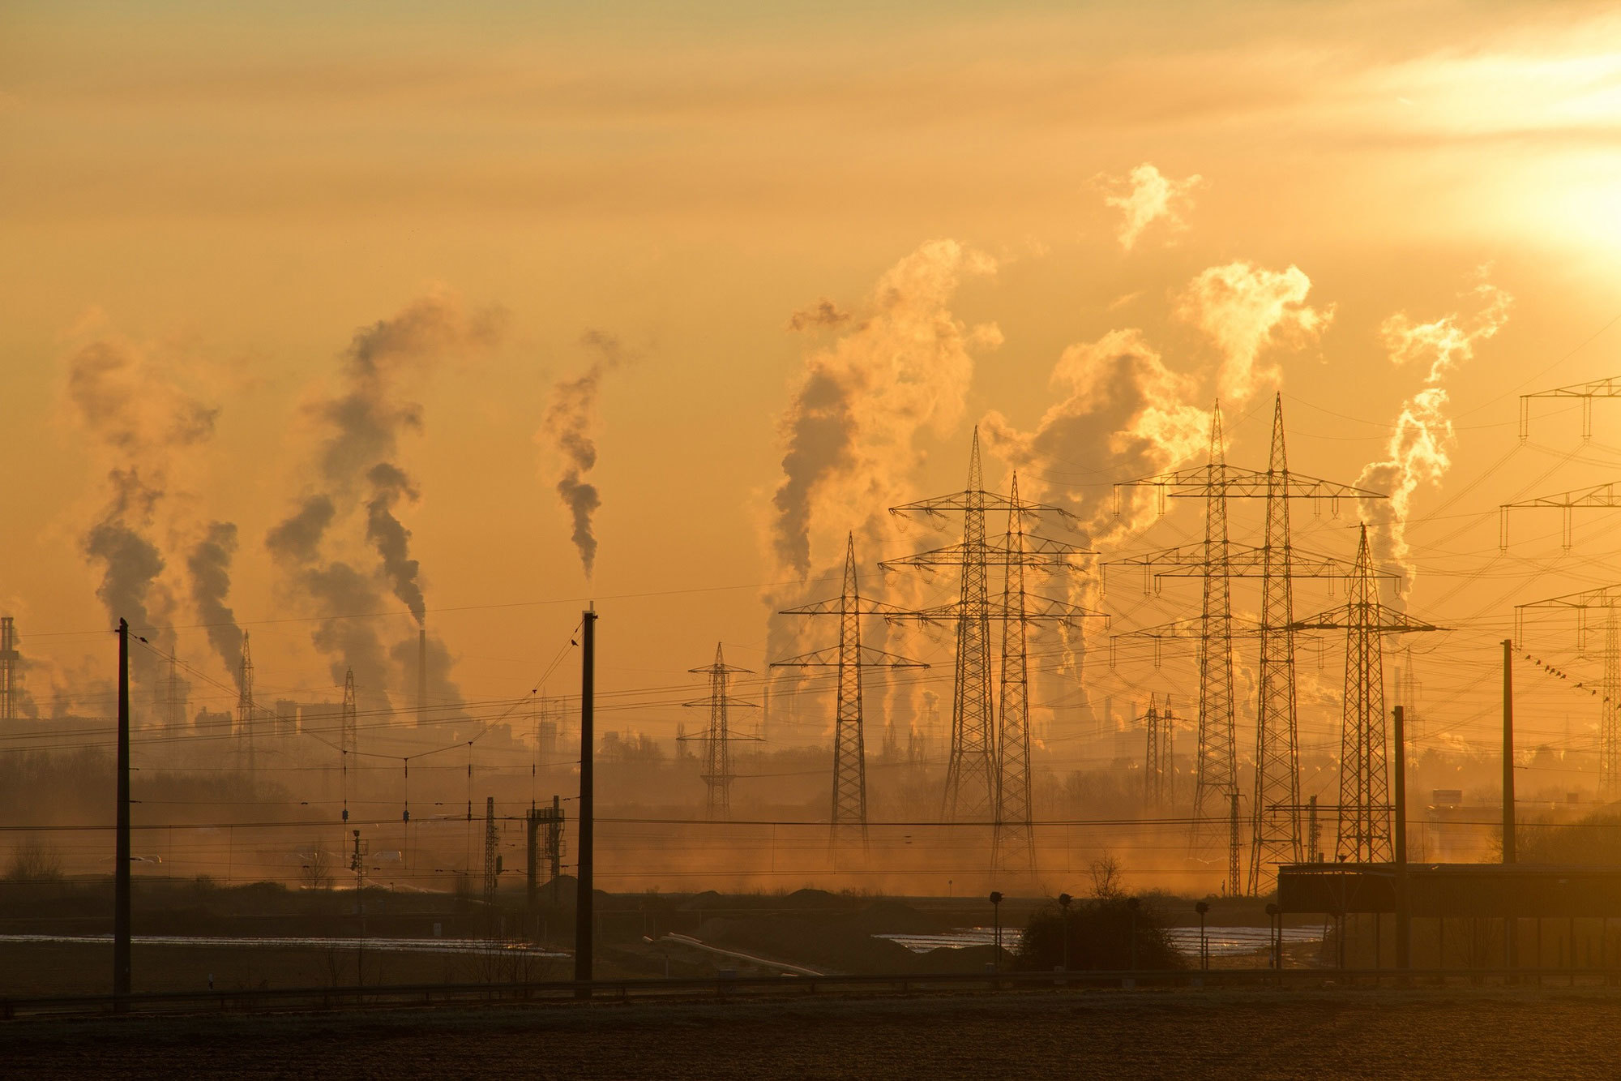
The Impact of Air Pollution and ESG

Slide 2
Agenda
Global Air quality and mitigation
ESG certification and Air pollution
Making buildings healthier
Healthy Air purifiers and how they can help

Slide 3

Key facts:
Low Air Quality
Significant Death Toll
According to the WHO the “combined effects of ambient air pollution and household air pollution is associated with 7 million premature deaths annually.”
The problem of air pollution is widespread with “around 2.6 billion people are exposed to dangerous levels of household air pollution.”
Covid-19 has been a primarily airborne disease leading to over 6 million deaths globally, with over 500 million confirmed cases and worldwide economic/social disruption.
Air Pollution contributes to a variety of other health conditions such as asthma, and according to the WHO “is responsible for 45% of all pneumonia deaths in children less than 5 years old”.
One of three countries lack any legally mandates standards for outdoor air quality. 92% of the worlds population live in paces where air pollution levels exceed safe limits.
Worldwide Effects
Covid-19
Health Impacts
Lack of awareness

Slide 4
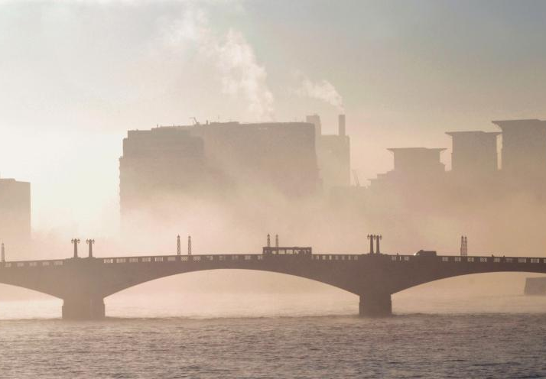
Ways to tackle air pollution and its effects
Lowering Carbon Emissions
CO2 emissions contribute to air pollution through exacerbating climate change, contributing to the formation of smog and allergenic air pollution. Reducing CO2 emissions must be the first step in tackling air pollution.
Cars release particulate matter, NOx and SOx which directly impact our health. Pressure must be applied on cities to promote electrification and alternate forms of travel, ie. Walking, Cycling, Trams etc.
The right to clean air does not exist in the public consciousness to the same degree that the right to clean water does, despite it’s devastating impacts. Pressure must be brought on MP’s and businesses.
Unfortunately cleaning up air pollution is a long-term task, and until the we all still suffer its effects. Air Purification and proper ventilation can reduce the most significant health effects and should be promoted and subsidised the same way clean water is. Studies are finding that areas that suffer from the worst levels of air pollution had an increased rate of death and severe effects from Covid-19 infection. The pandemic and its lingering effects provide one way to bring attention to these inequalities and improve public awareness of the issue.
Alternative Modes of Travel
Promoting human rights
Air Purification
Promoting Awareness and Covid-19

Slide 5
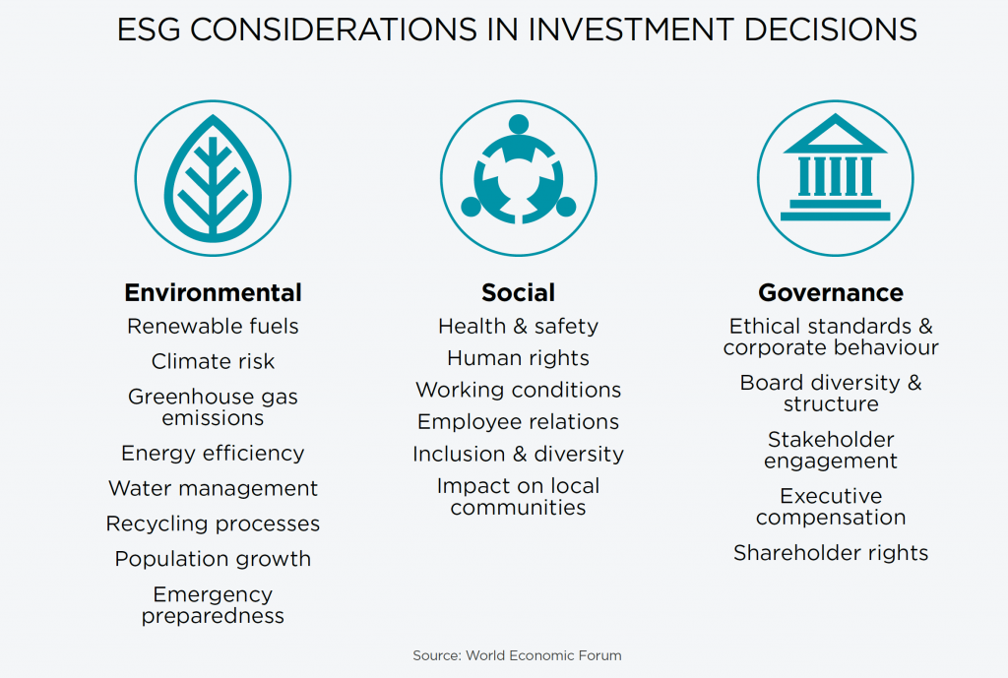
ESG certification and clean air

Slide 6

In 2015, the United Nations and its Member States adopted the 17 Sustainable Development Goals (SDGs) as a blueprint for addressing the global challenges of poverty, environmental protection, peace and prosperity by 2030

Slide 7

Correlation with UN sustainability goals
UN Sustainability Goal 3, Good Health and Well-Being
A good air purification strategy will reduce airborne infections and fights against long term health issues helping to reduce sick days and improving quality of life and productivity.

Slide 8

Correlation with UN sustainability goals
UN Sustainability Goal 10, Reduced Inequalities
Developing countries and urban centres with higher levels of air pollution significantly benefit from access to clean air.
*Air Purifiers enable global access to clean indoor air independent of local levels of air pollution

Slide 9

Correlation with UN sustainability goals
UN Sustainability Goal 13, Climate Action
Reduction of energy demand is the first step in becoming more energy efficient in buildings
*Best Practise Air Purifiers can reduce the carbon footprint of any building employing heating or cooling systems by reducing the amount of recommended air exchange rates for the building, in turn lowering the energy usage.
*Energy efficient

Slide 10
George Adams
SPIE – Engineering Director
CIBSE – Ex President

Slide 11
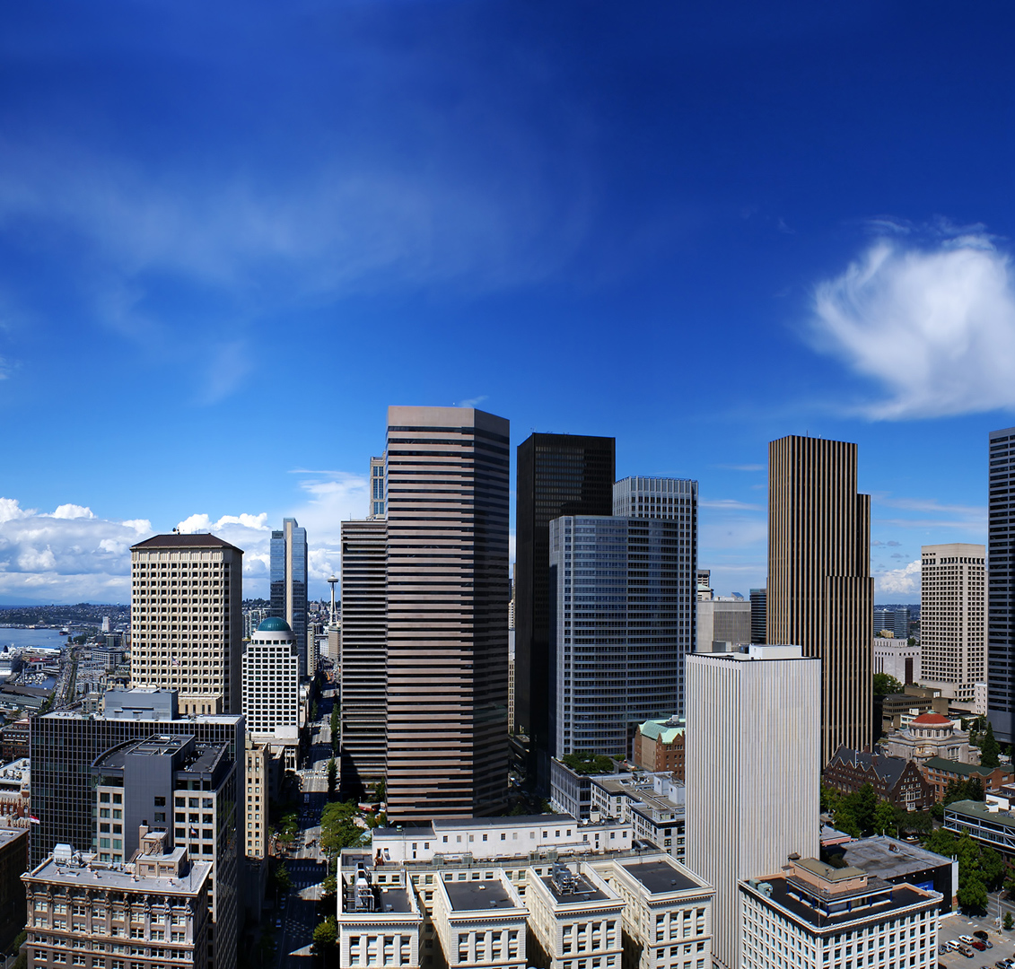
The need to make buildings healthier
We spend up to 90% of our time in buildings
COVID 19 proved it is time to make buildings more health-safe for people
Mental well being is becoming better known – but what about bacteria and viruses?
We now have more technology to help us, so why not use it?
Why? People moving into cities, by 2030 could be 70% of the world population

Slide 12

The need for society to change
With improved air quality various tests show higher results in the cognitive tasks
Buildings we spend most of our time in have a real impact on our health, productivity, and creativity
Technology can significantly improve conditions in buildings
Do we know or accept the consequences of ignoring or delaying this changes society needs to make?

Slide 13
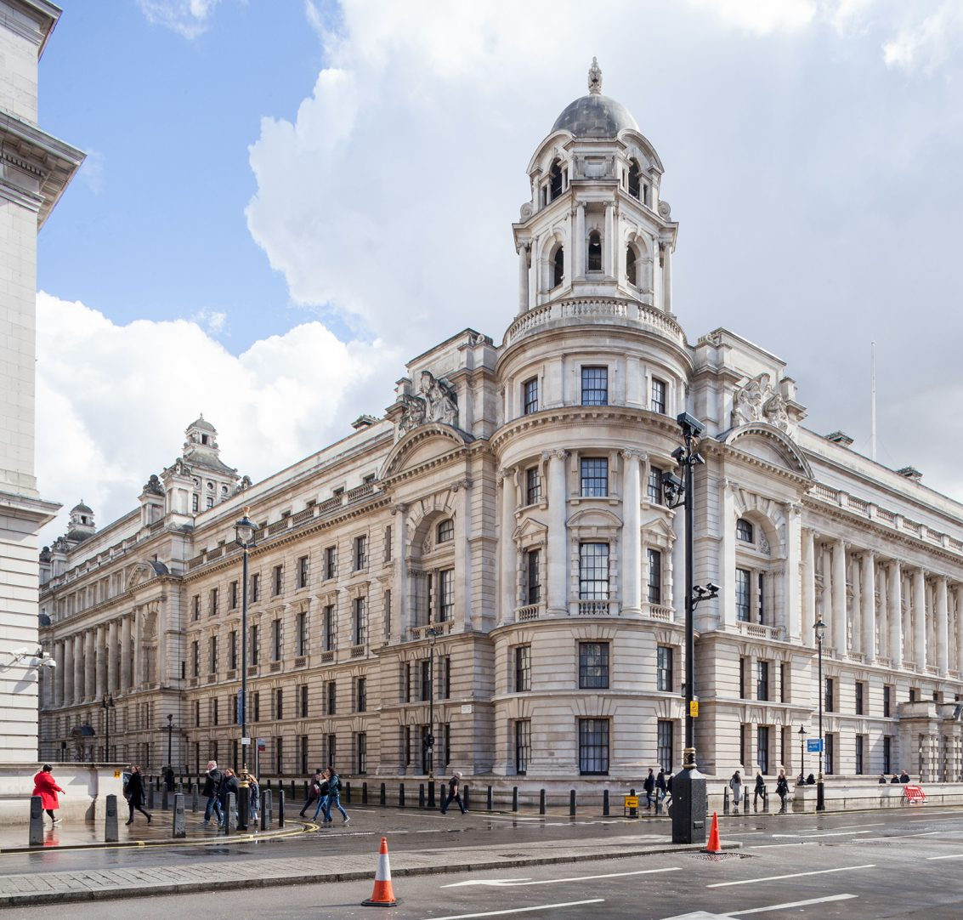
The vast majority of existing buildings still being with us in the future?
The need to improve existing buildings still being with us in the future
Can Health-safe be the next stage of Energy Efficient/Net Zero?
Technology has moved on at pace to offer a selection of solutions to assist in making buildings Health-Safe

Slide 14
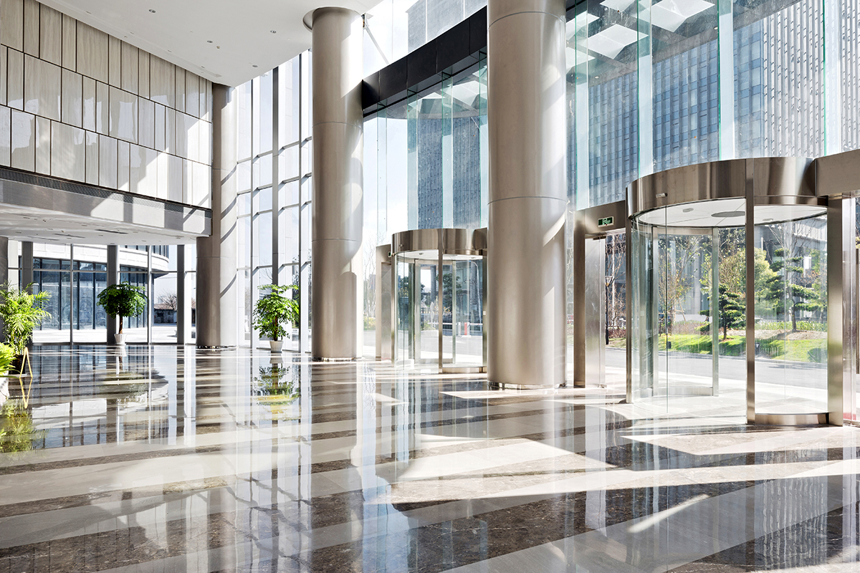
The absolute need for healthier buildings
Buildings provide various needs of society
Buildings for peoples needs in society provide shelter, security, living space, privacy, store belongings, provision of energy, comfort to live and work-in, and to contribute to wellbeing
Key features of a healthy building?
Acoustics, lighting, air quality, ventilation, filtration, thermal control, humidity levels, bacteria and virus control
Creating Healthy and Sustainable Building
The specific skills required for the energy-saving, resource-saving, healthy and complainant requirements for the benefit of society

Slide 15
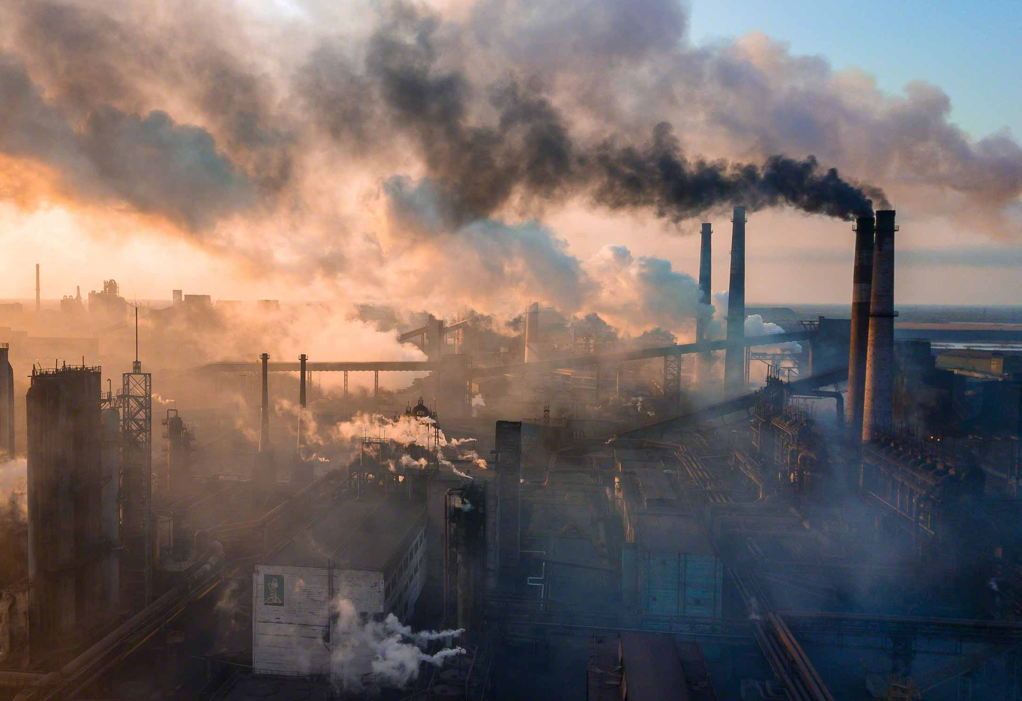
The consequences of ignoring or delaying need for change
According to the model of Barton and Grant in 2006, the natural and built environments are critical health determinants, both of which can influence a population’s health.
The concept of the healthy building was introduced by Ho et al. 2004 and defined as a “built environment that encourages positive well-being of human beings”.
So are these still true today?

Slide 16
Healthy Air Technology
The Sensible Solution

Slide 17

Who are we?
Healthy Air Wherever You Are
Innovative Technology:
Developed by an Oxford University Scientist
Developing smart integration
Formula 1 Airflow technology
Air Purification Perfected:
Industry best filtration
Efficient and sustainable design
Kills viruses (including coronaviruses)
A product for everyone:
Top choice for European hospitals and dentists
Used by: Private Eye, Mars, British Olympic Athletes and many more

Slide 18
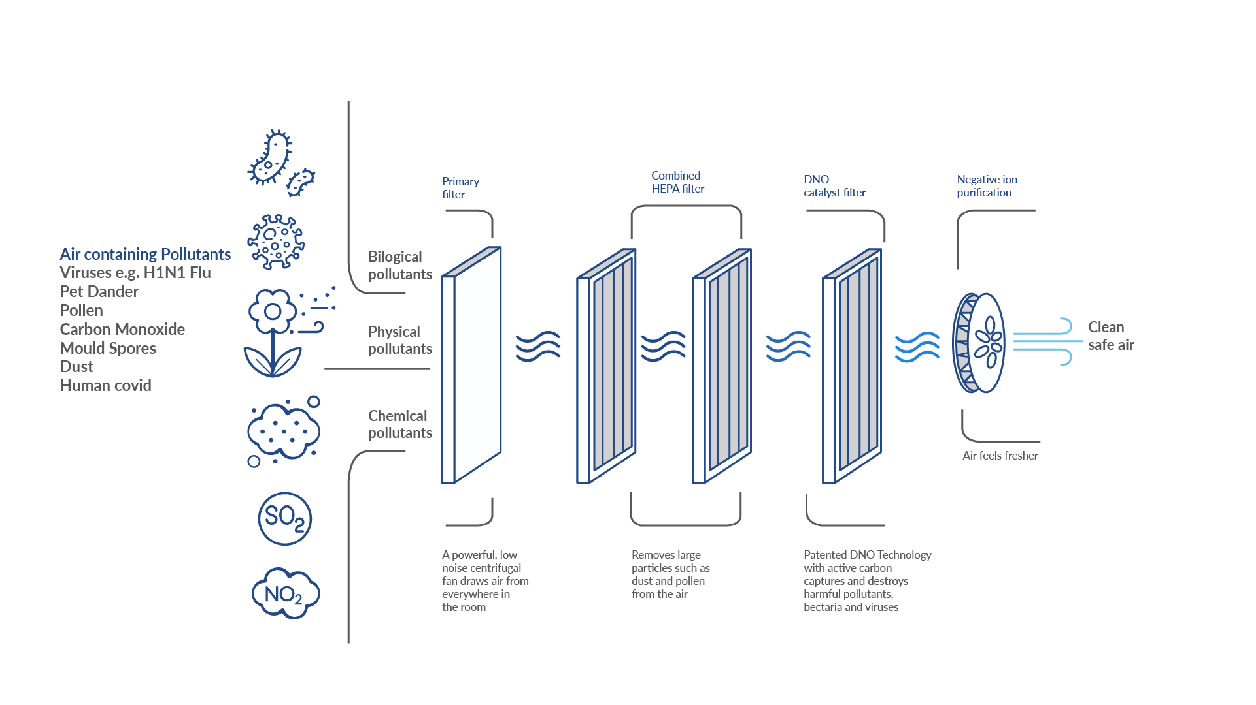
Healthy Air Products
-DNO Technology-
18
Notes:
Using ground-breaking multi-patented DNO Pollution Erasing Technology invented by chemists in Oxford, the four-stage filtration system pulls in the contaminated air from around the room, capturing and destroying germs, bacteria and dangerous gases.
Two large inlet multi-patented DNO filter cartridges draw a large volume of air through the four-stage filtration system. A powerful fan projects a strong upward flow of fresh air, pushing it into the far reaches of the room and drawing in the uncleaned contaminated air.

Slide 19
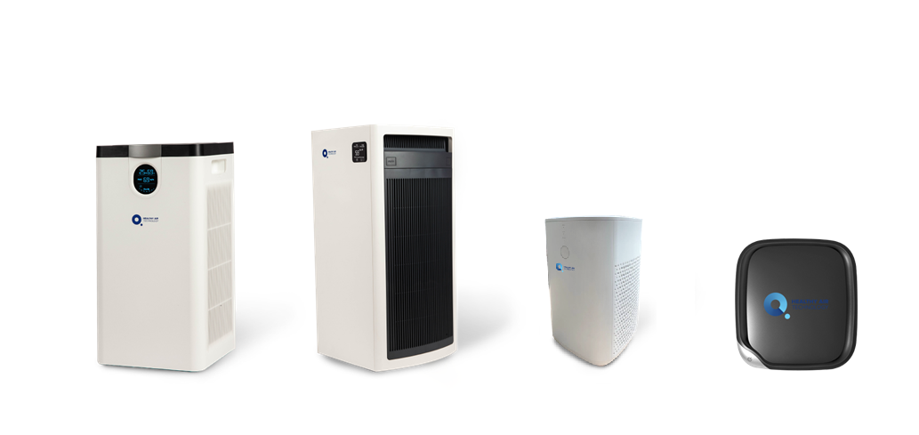
Four machines are available to fit any indoor or travel environment.
Solutions
HA500
Home air purifier
HA800
Commercial air purifier
HA55
Desktop air purifier
HA30
Car air purifier
Unique core technology, strong IP Patented, Design rights, Trademarks & Domain rights, RED Dot design award.
An App for home and commercial unit is on the way.
19

Slide 20


Slide 21

Contact us:
www.healthyairtech.com
info@healthyairtech.com

